Slide 1


Florida Bright Futures scholarship
Gina McFarland
COMP 4433

Slide 2

What is the bright futures Scholarship?
Bright Futures is a merit-based scholarship program based on academic performance, standardized test scores, and community service. Students with higher academic performance receive higher levels of aid.
This Photo by Unknown Author is licensed under CC BY-ND
Florida Academic Scholars
Florida Medallion Scholars
Florida Gold Seal Vocational Scholars
100% Tuition and Fees at ANY Florida state college/university, plus $300 stipend
75% Tuition and Fees ANY Florida state college/university
75% Tuition and Fees AT any Florida vocational school
(Florida Bright Futures Program Details, n.d.)

Slide 3
Merit-Based scholarships are a growing trend

Slide 4

What ARE the Goals of bright futures?
Help reduce the effects of rising college prices on middle income families
Promote better preparation for college while students are in high school
Promote better academic achievement after students reach college
4. Save money by better preparing students
less likely to need remedial courses
more likely to complete their degree programs in timely manner
Encourage talented students to attend in-state colleges and remain residents after graduation
This Photo by Unknown Author is licensed under CC BY-ND
(Mckinney, 2009)

Slide 5


Is bright futures achieving its goals?
Help reduce the effects of rising college prices on middle income families
Promote better preparation for college while students are in high school
Promote better academic achievement after students reach college
The evidence shows middle income families have more affordable college choices.
College attendance and number of degrees earned are both up which may indicate better preparation. Or, it may just be a reflection of increased opportunity to attend college. Some data indicates teachers are inflating grades to keep students eligible for Bright Futures.
Unclear. Some policy papers mention Bright Futures is effective in promoting academic achievement. This is likely based on the requirement to maintain a relatively high GPA to keep eligibility. However, evidence shows students are avoiding challenging curricula to maintain eligibility. Students in science, engineering, and computing programs frequently lose their Bright Futures scholarships.
(OPPAGA, 2004)
(Zhang, 2013)

Slide 6

Is bright futures achieving its goals?
Save money by better preparing students
less likely to need remedial courses
more likely to complete their degree programs in timely manner
Encourage talented students to attend in-state colleges and remain residents after graduation
The families of students receiving the scholarship are certainly saving money. However, this has become an extremely costly program for the state. There was no specific data about remedial courses or degree completion time, so this goal is unclear.
The program increases freshman college enrollment, in part due to reduced out-migration, and increased degree production. Also, students are much more likely to reside in Florida post-graduation than those who are not eligible for the program.
(Hickman, 2009), (Zhang, 2013)

Slide 7
What’s the problem?
Well, it turns out there are several….
Expensive: Costs have increased 3x in just the past 4 years
Inefficient: often gives money to students who do not need assistance and would have attended college anyway
Tuition Anchor: State colleges have difficulty raising tuition because it affects Bright Futures program solvency
Regressive: Shifts resources from low and middle income families to upper-income families
Inequitable: White students typically receive 3x as many awards as black and Hispanic students combined
(Mckinney, 2009)

Slide 8
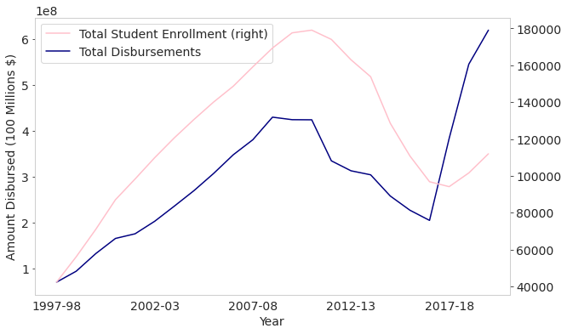
Focusing on the issues….
1. Ballooning Costs
Why?
1. Increase in Tuition and Fees
2. Enrollment Growth
(In that order)

Slide 9

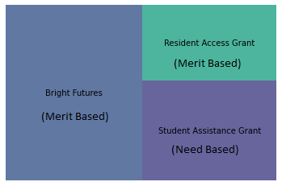

Focusing on the issues….
Inefficient: Bright Futures is sometimes called the ‘BMW Scholarship’ because it allows wealthy families to spend their college savings on a car for their student
Since the goal is to send the maximum number of students to college, funding those who would have gone anyway not a good use of resources
This Photo by Unknown Author is licensed under CC BY-ND
In 2007:
95+% of incoming freshman at UF received Bright Futures funds
Median income of UF families was $100,000
Florida 2015 College Assistance Distribution

Slide 10
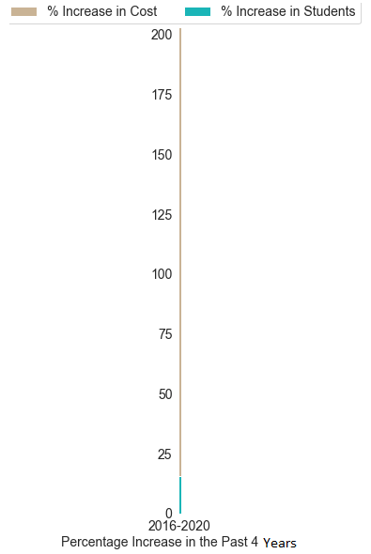
Focusing on the issues….
Tuition Anchor: Universities face resistance in raising tuition despite increased enrollment and decreased state spending on colleges and universities. Universities may ‘break’ the state’s budget and Bright Futures program solvency by increasing tuition and fees.
Since the Great Recession, Florida is funding 13% LESS per student
No tuition increases from 2013 – 2020
A combination of increased Bright Futures enrollment, increased fees, and finally an increase in tuition in 2020 have driven costs up over 200% in the past 4 years
The graph demonstrates that despite only a 16% increase in students, there was a 200% increase in costs in the past 4 years. The concerns about the effects of raising tuition on Bright Futures solvency have been realized.

Slide 11
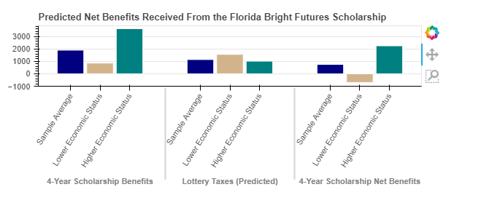
Focusing on the issues….
Regressive: Studies have shown that the majority of lottery participants are from lower socioeconomic classes and the majority of Bright Future scholarship recipients are from higher socioeconomic classes. The scholarships result in a reverse Robin Hood effect.
2004 data demonstrating lottery scholarship benefits, lottery taxes and net benefits by socioeconomic class, including a $-700 per resident scholarship benefit for lower socioeconomic residents. (Stranahan, 2004)

Slide 12
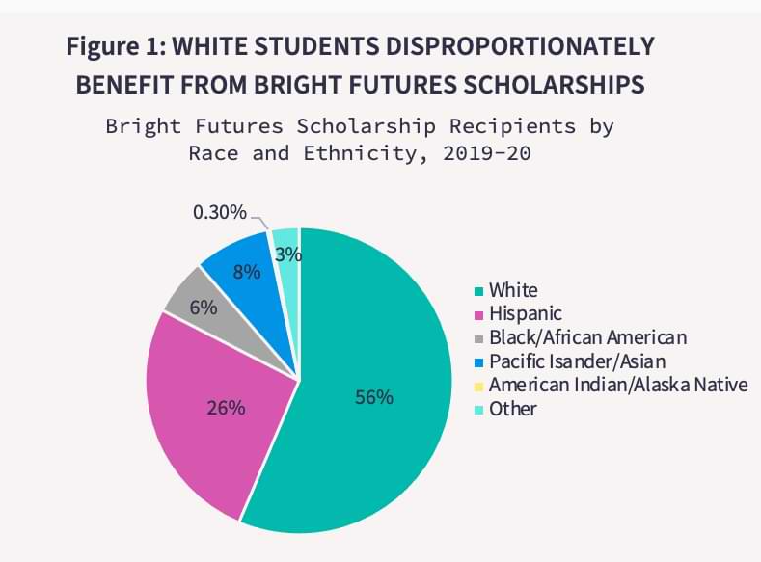
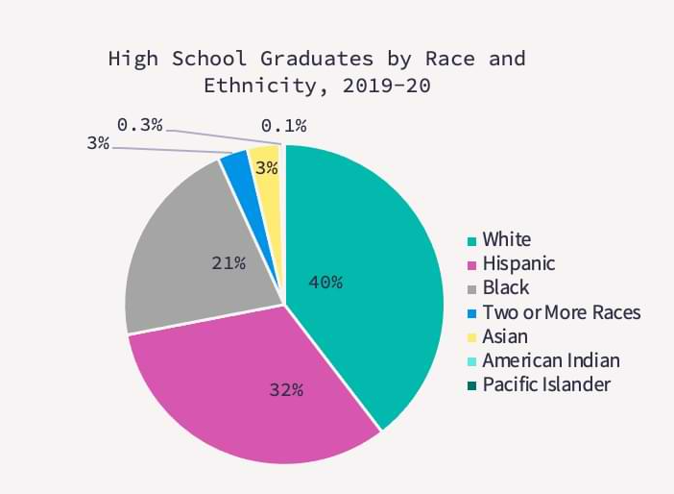
Focusing on the issues….
Inequitable: White students receive far more scholarships than minorities each year
Source: www.floridapoliicy.org
Source: www.floridapoliicy.org
Percentage of Hispanic recipients has grown (15% in 2007)
Black recipients have never exceeded 7% of scholarships given
(Bullard, 2021)

Slide 13
What options are there?
Maintain status quo
Pros:
High Political Demand
Helps middle class afford college
Keeps talent in Florida
supports thousands of students in college attendance
Cons:
Long term Fiscal problems
Keeps educational institutions from much needed tuition raises
Benefits wealthy students who would have attended college anyway
Lack of distribution equity
Implement Flat-rate scholarship award amounts
Pros:
Immediate program savings
Would allow educational institutions to raise tuition
Reduced political barriers since similar to current plan
Cons:
Flat rate may not be enough to keep talented students in-state
Would still benefit students from affluent families / not maximize number of students who attend college
Distribution equity issues would remain
(Mckinney, 2009)

Slide 14
What options are there?
establish a 'blended' program that provides both merit and need-based aid
this model would lower eligibility requirements, give a lower base amount, and give supplemental aid to top performing students and students from low-income families
Pros:
Help a greater number of students
More cost efficient approach since helping more students who would not have attended without assistance
High performers could receive same amount as current bright futures program
More equitable
Cons:
Could increase costs, depending on base amount given
Likely to be politically unpopular due to reduced awards to middle performers
Establish a primarily need-based aid program
Florida currently spends 3:1 on merit to need based aid. This plan would flip that ratio and focus lottery revenue on households making less than $36,000/year with remaining funding bright futures.
Pros:
Reduce bright futures costs since funding fewer students
Potential to maximize student attendance if low-income student attend / graduate college
More equitable
Cons:
Research shows many low-income students who would benefit would not persist until graduation
No academic requirements to receive aid may mean that recipients are not prepared for college academic rigor
more cost efficient if students earn degrees; otherwise will have low cost-efficiency if many drop out
(Mckinney, 2009)

Slide 15

Recommendation
Implement Option 3, Blended Program
Tennessee HOPE program is a model
Maintain rewards for talented students
Help students who would not attend college otherwise
Lottery proceeds would benefit the community that funded it
Options to control costs by adjusting base award amount
This Photo by Unknown Author is licensed under CC BY-ND

Slide 16
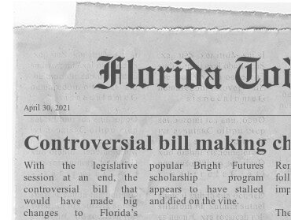
Is This change likely?
Unfortunately, no.
The Blended Plan policy proposal was put forth in 2009 by University of Florida in the Florida Journal of Educational Administration & Policy; no action has been taking towards a plan like this
https://www.fodey.com/generators/newspaper/snippet.asp
In 2011 Bright Futures cut recipients by raising the minimum SAT score
This led to the precipitous drop in students and costs shown in the graph on slide 8
This reduced minority recipients and led to a US Dept of Education investigation on racial bias in the program
Disparate effects on minorities were found to be an inadvertent side effect
In April 2021 there was another push for reform
The Florida Senate passed a bill in which yearly funding for Bright Futures was tied to the state budget instead of guaranteeing the scholarships
The Florida House did not take action on the bill, so no change occurred
Legislature agreed to remove $600 annual textbook stipend, saving $37.5 million/year
Parents of high performing students are wary that these initiatives will resurface next year and suggest their students may take full-ride opportunities out of state since Bright Future’s future is uncertain
(Gallion, 2021), (McGlade, 2016), (Smiley, 2014)

Slide 17
References:
Bullard, H. (2021, January 28). Lawmakers Must Reshape the Bright Futures Program to Build a
More Equitable Florida. FPI Home. https://www.floridapolicy.org/posts/to-build-a-more - equitable-florida-lawmakers-must-reshape-bright-futures- program#:~:text=Only%206%20percent%20of%20Bright,has%20never%20exceeded%207%20 percent.
Florida Bright Futures Program Details: UF Office of Student Financial Aid and Scholarships. SFA
Financial Aid Help. (n.d.). https://www.sfa.ufl.edu/types-of-aid/bright-futures/florida-bright- futures- program-details/.
Gallion, B. (2021, April 30). Controversial bill making changes to Bright Futures remains stalled in Florida House. Florida Today. https://www.floridatoday.com/story/news/education/2021/04/30/controversial-bright-futures-bill- stalls-house/7249580002/
Hickman, D. (2009). The effects of higher education policy on the location decision of individuals: Evidence from Florida’s Bright Futures Scholarship Program [Review of The effects of higher education policy on the location decision of individuals: Evidence from Florida’s Bright Futures Scholarship Program]. Regional Science and Urban Economics, 39. www.elsevier.com/ locate/ regec

Slide 18
McGlade, C., & Travis, S. (2016, October 21). Minorities, poor hit hardest by stricter Bright Futures requirements. Sun-Sentinel.com. https://www.sun-sentinel.com/news/education/sfl- minorities-poor-hit-hardest-by-bright-futures-changes-20161021-htmlstory.html
Mckinney, L. (2009). An Analysis of Policy Solutions to Improve the Efficiency and Equity of Florida’s Bright Futures Scholarship Program. Florida Journal of Educational Administration &amp; Policy, 2(2), 85–101. https://eric.ed.gov/?id=EJ930108.
Mitchell, M. (2018, October 4). Unkept Promises: State Cuts to Higher Education Threaten Access and Equity. Center on Budget and Policy Priorities. https://www.cbpp.org/research/state-budget-and- tax/unkept-promises-state-cuts-to- higher-education-threaten-access-and.
OPPAGA. (2004, March). https://silo.tips/download/march-2004-report-no. Most Bright Futures Scholars Perform Well and Remain Enrolled in College. https://silo.tips/download/march- 2004-report-no.
PEPC. (1999, December). Florida's Bright Futures Scholarship Program: A Baseline Evaluation. https://www.fasfaa.org/assets/FL_Aid_History/%281999%29%20Florida%27s%20Bright%20Futu res%20Scholarship%20Program%20-%20A%20Baseline%20Evaluation.pdf.

Slide 19
Smiley, D., & McGrory, K. (2014, September 17). Feds investigate Florida’s Bright Futures scholarships. Miami Herald. https://www.miamiherald.com/news/local/education/article1961828.html
Stranahan, H. A., & Borg, M. O. (2004). Some Futures are Brighter than Others: the Net Benefits Received by Florida Bright Futures Scholarship Recipients. Public Finance Review, 32(1), 105– 126. https://doi.org/10.1177/1091142103258229
Tennessee Higher Education Commission. (2012, July). A Comparison of States' Lottery Scholarship Programs. https://thec.ppr.tn.gov/THECSIS/Lottery/pdfs/SpecialReports/A%20Comparison%20of%20St ates'%20Lottery%20Scholarship%20Programs%20120717.pdf.
Zhang, L., Hu, S., & Sensenig, V. (2013). The Effect of Florida's Bright Futures Program on College Enrollment and Degree Production: An Aggregated-Level Analysis. Research in Higher Education, 54(7), 746-764. https://doi.org/10.1007/s11162-013-9293-8

